Slide 1

Airport Delays Database Analytics
The Crumple-Horned Snorkack Daniel Chang, James Khamthung, Robert Blue, and Santiago Gutierrez

Slide 2
Introduction
Flight delays are a significant issue in civil aviation.
Airport management
Missed Connections
Scheduling Disruptions
Delays
Stranded Passengers
Crew Scheduling
Connection to Data Science
Gather data via API & other methods(Kaggle)
Create database.
We want to help analyze flight delays that can be avoided by combining flight, air traffic control, and weather data.
decomposes and locates the causes of real-time delays to provide a foundation for managers to make decisions

Slide 3
Data Collection
The U.S. Department of Transportation's (DOT) Bureau of Transportation Statistics tracks the on-time performance of domestic flights operated by large air carriers.
Summary information on the number of on-time, delayed, canceled, and diverted flights are published in DOT's monthly Air Travel Consumer Report and this dataset of 2015 flight delays and cancellations.
The DOT's Bureau of Transportation Statistics collected and published the flight delay and cancellation data. We merely inspected, cleaned, and analyzed the data based on our needs.

Slide 4
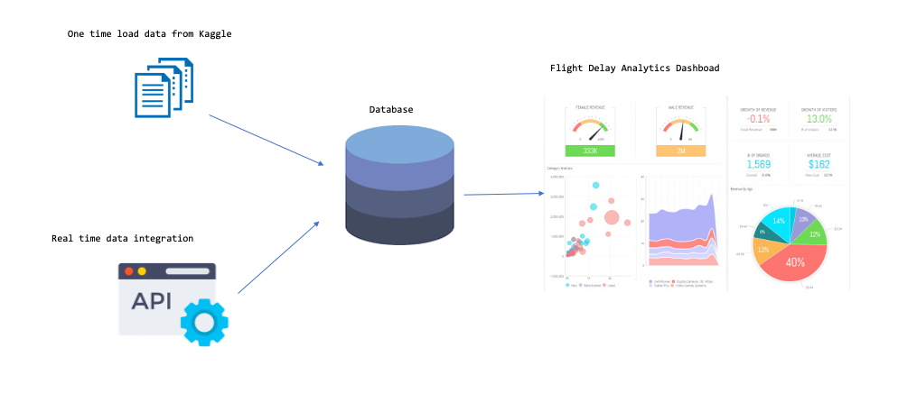
MySQL Methodology
The methodology of using MySQL involves:
Creating a database.
Creating tables to hold the extracted data.
Extracting and transforming the data.
Loading data into the MySQL database.
Running queries.
Analyzing results.
Eventual creation of dashboard.

Slide 5
Database
We began by developing a database and loading the dataset into the database.
Our dataset is mostly taken from Kaggle and contains flight delays and cancellations collected and published by the DOT's Bureau of Transportation Statistics.

Slide 6
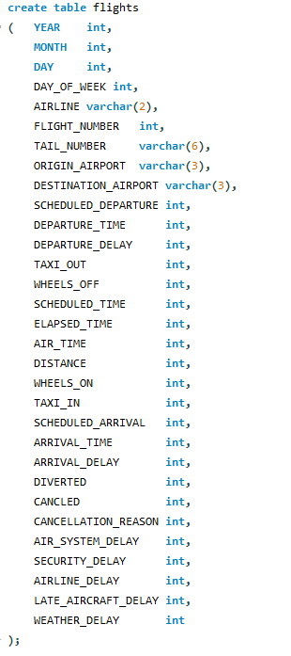
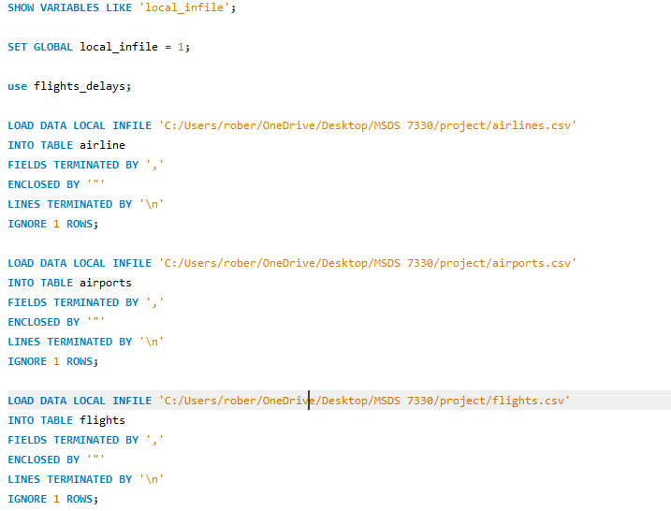
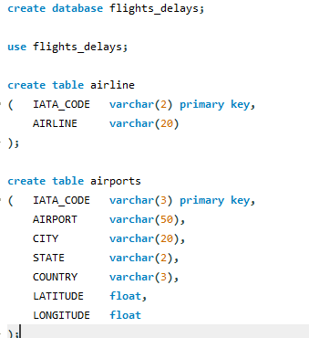
Building the SQL database

Slide 7
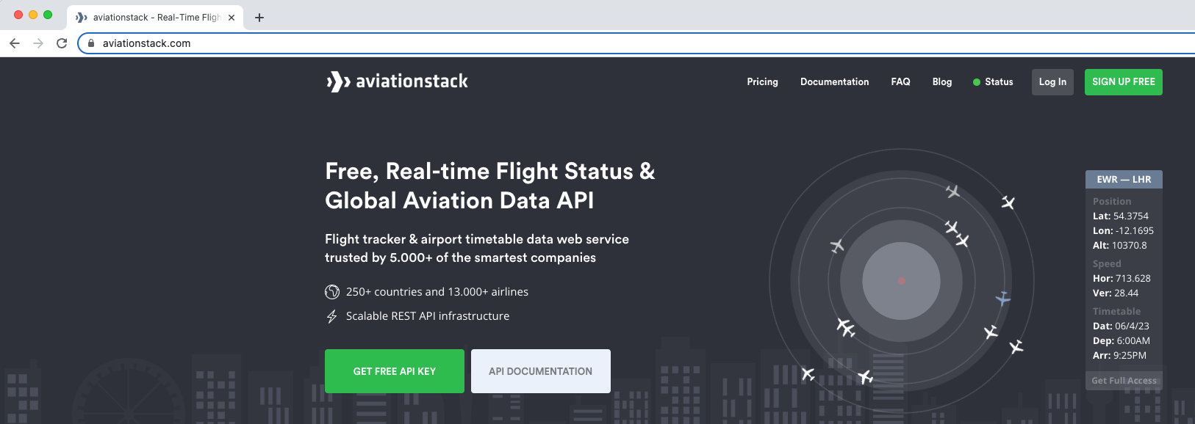
API/Real Time/Semi-Structured Data
The aviationstack API - accessing global aviation data for real-time and historical flights
https://api.aviationstack.com/v1/flights
API response in JSON format
Transform/Extract
Load into Database

Slide 8
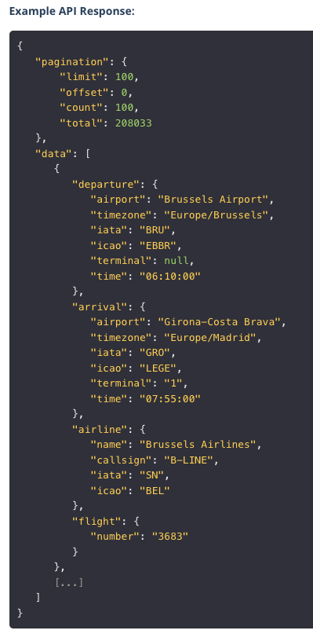
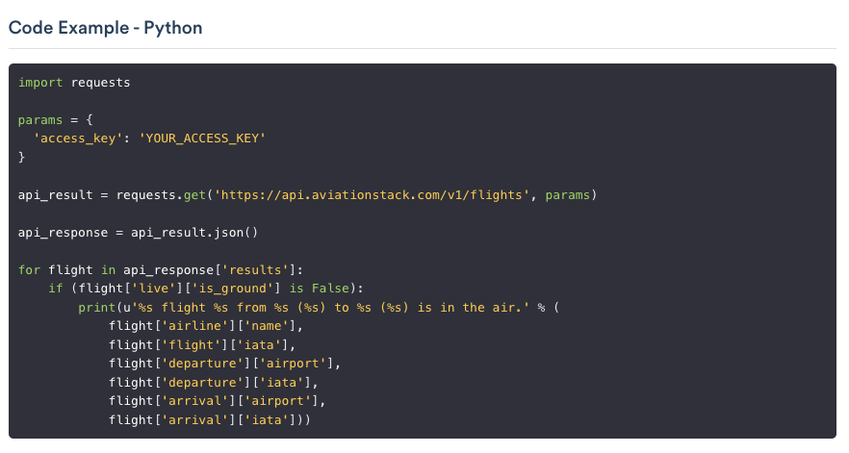
API/Real Time/Semi-Structured Data

Slide 9
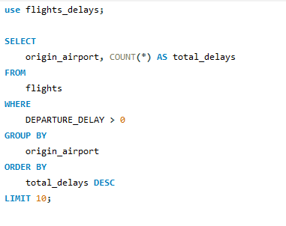
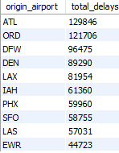
Data Analysis - Finding the top 10 airports that have flight delays

Slide 10
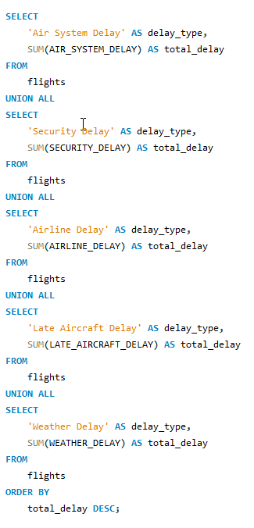
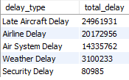
Data Analysis - Finding the total delays by type in 2015

Slide 11
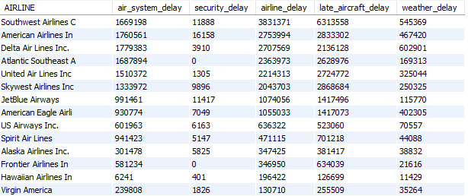
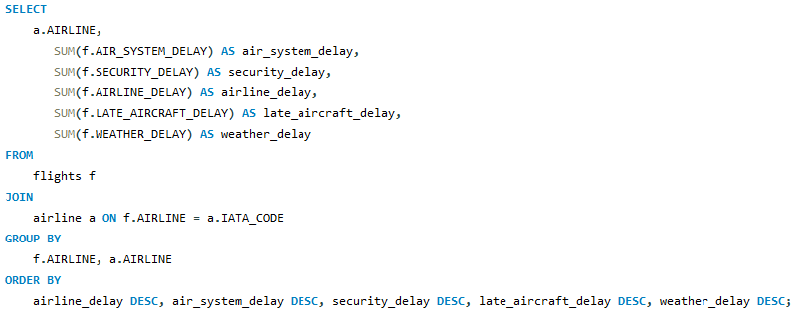
Data Analysis - Finding the top delay reasons per Airline by time

Slide 12
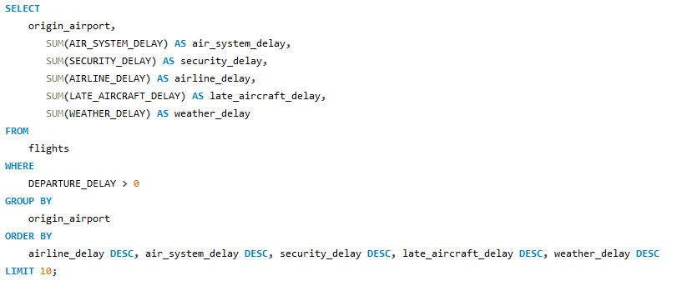
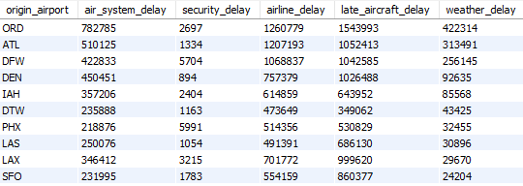
Data Analysis - Finding the top delay reasons per airport by time

Slide 13
Thank You!
Questions?
Daniel Chang - changd@mail.smu.edu
Santiago Gutiérrez - gutierrezs@smu.edu
Robert Blue - rblue@smu.edu
James Khamthung - jkhamthung@smu.edu

